Slide 1
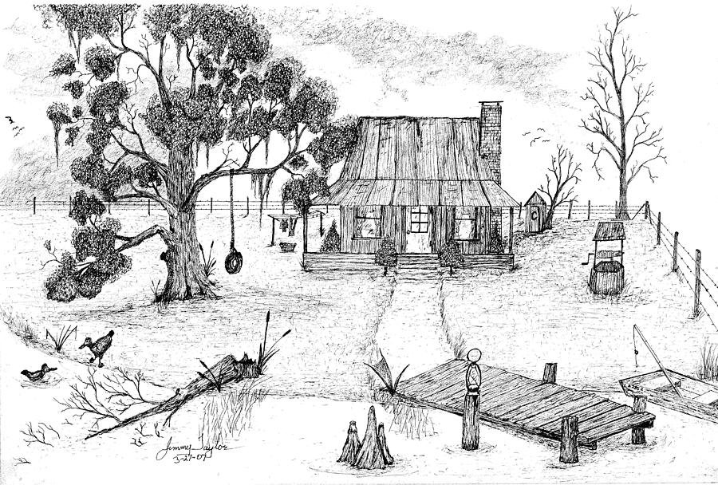
Kate Chopin as a Vocal Colourist
Vocalscapes in “Beyond the Bayou” (1894)

Slide 2
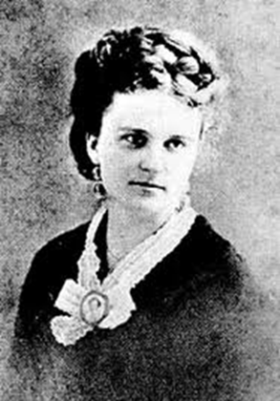
Introduction
Kate Chopin is well known for her rendering of dialects and accents (“local colourist” usual. derogatory)
Less attention has been paid to her use of PVF,
PVFs and dialect encoding give her stories an oral quality and create a vocalscape in which the action is set.
These features find an echo in the narrative voice that takes on an oral quality.
What is present in the plot is reverberated in the narrative.

Slide 3
Introduction
// William Labov’s “oral narratives of personal experience”.
Folk-tale quality of the story.
The abstract is accurately represented by the title, as the story is actually about La Folle’s crossing the Bayou.
The orientation : lengthy. The central characters & the general backdrop are precisely depicted.
The complicating action is Chéri’s shooting accident and the consequences on La Folle’s behaviour.
No coda: suggests that the conclusion of the story may not be as straightforward as could be anticipated.
Evaluative devices are to be found in the change of perspective present at the end.
The very simplicity of the plot with its poignant climax along its well-ordered chronology evoke traditional oral narratives.

Slide 4
1. Vocal colour & linguistic identification
Chopin is quite successful in encoding accents.
In Louisiana, several linguistic varieties co-exist:
  French Creole /kri@Ul/
  Cajun /keIdZn/
  Acadian French
  A variety of English: Yat, a New Orleans accent > “Where y’at?”
  This accent shares phonetic features with Brooklynese,.
Linguistic hotchpotch : accurate depiction of the linguistic situation.

Slide 5
1. Vocal colour & linguistic identification
The French past of Lousiana is present in the referential world through toponymy, proper names and nicknames:
  The plantation is called Bellissime – French / Latin
  Jacqueline = “La Folle”, the boy = “Chéri” ; father = “P’tit Maître”.
La Folle : Louisana French Creole + a dialect of English.
1891 version:
  “He used to kiss me so lovingly!” La Folle said to herself in her dialect.
KC aware of the difficulty of encoding dialect & prepares the (cognitive) ground.
DS is presented in Standard English despite inquit.
Usually, to evoke Louisiana English → morpho-phonological encoding (plays with spelling).

Slide 6
1. Vocal colour & linguistic identification
Regional speech pointers :
Loss of the velar nasal /N/ in ING forms: “She goin’ be”.
TH Stopping; <th> realised /d/ /t/. /t-T/ /d-D/ oppositions lost: “De bayou. “Dat’s too big”.
Non-rhoticity. Unlike G.A., South A.E. tends to be non-rhotic. “I come ax how my po’ li’l” Chéri to, ‘s mo’ning & “One squirrel ain’t a bite. I’ll bring you mo’ ‘an one, La Folle”.
/I/ /e/ neutralisation encoded with “till” for “tell” and “ef” for “if”.

Slide 7
1. Vocal colour & linguistic identification
The blend of French words and Lousiana speech → accurate idea of characters’ accents. Not mere elements of realism.
French = a sympathy-marker. La Folle’s viewpoint that is adopted :
She called him Chéri, and so did every one else because she did. (56).
Also: French = tension & intense emotions.
“Regional speech pointers are often increased when the speaker is under emotional pressure”. (Chapman, 1994, 61)
When there is no other issue than to cross the Bayou:
  She spoke no more to Chéri, but muttered constantly, “Bon Dieu, ayez pitié La Folle! Bon Dieu, ayez pitié moi!”.
French only + PVF (muttered)

Slide 8
This linguistic versatility gives a remarkably accurate picture of the community presented and provides clues for the general evaluation of the story.
In KC’s writing, accent encoding goes well beyond the mere stereotypical presentation of the speech of a given locality: it has a major functional role.
Paralinguistic vocal features work similarly.
They are emotion markers and appear in clusters in emotionally charged episodes. They therefore enable readers to follow La Folle’s progression across the Bayou.

Slide 9
2. PVF as motion and emotion markers
The relationship between La Folle and Chéri is based on complicity.
The PVFs used are congruent with this and the vocal registers of the characters are attuned:
La Folle is first amused at Chéri’s manly behaviour:
  “boasting”;“boasting pompously” met with “gaily to him” and La Folle “laughs”.

Slide 10
2. PVF as motion and emotion markers
The shooting accident is brought about vocally first and the “sharp cry of distress” threatens to unbalance the vocal harmony previously established.
Yet, the vocal coherence is maintained. Both characters play their parts:
PVFs used respond to one another: emphasis on the bond between them:
  “He moaned piteously: – “I’m dead, La Folle! I’m dead! I’m gone!”
  “Non, non!” she exclaimed resolutely, as she knelt down beside him”.
  “Now, with his head upon the woman’s shoulder, he moaned and wept with pain and fright.’Oh, La Folle! La Folle! It hurt so bad! I can’ stan’ it, La Folle!’”
  “Don’t cry, mon bébé, mon Chéri!“ the woman spoke smoothingly to him as she covered the ground with long strides”.
Although the vocal registers have changed, no vocal disruption as such has yet occurred.

Slide 11
2. PVF as motion and emotion markers
Vocal disorder when La Folle reaches the bank of the Bayou :
  “Oh, P’tit Maître! P’tit Maître! Venez donc! Au secours! Au secours!” .
NRSA then take over: emotions + important than content of speech.
  She shouted, she wailed; but whether her voice remained unheard or unheeded, no reply came to her frenzied cries.
The progression points to a major vocal change.
The same is true of Chéri’s words, also in NRSP:
  And all the while, Chéri moaned and wept and entreated to be taken home to his mother.
The overlap (rare in fiction) increases the vocal disruption.
  “No voice responded” : a narrative counterpoint to vocal din.

Slide 12
2. PVF as motion and emotion markers
The vocal element foregrounded. Inhabitants = absent voices:
  She called for each and every one upon the place, and still no answer came.
La Folle’s cries are not answered YET her motions have a vocal effect
NRSA confirmed by DS :
  A child, playing in some weeds, caught sight of her as she neared the quarters. The little one uttered a cry of dismay.
  “La Folle! She screamed, in her piercing treble. “La Folle done cross de Bayer!”
Real subject matter : La Folle’s crossing the Bayou (not Chéri’s accident) see Title.
After collapse: only info concerns her health (description of voice):
  The voice was very clear and steady with which she spoke to Tante Lizette, brewing her tisane there in a corner.
The deviant pseudo-cleft structure thematises La Folle’s voice and presents it as her sole defining feature.

Slide 13
3. A sense of peace and order?
All the binary tensions seem to disappear.
Sense of harmony and beauty prevails:
A look of wonder and deep content crept into her face as she watched for the first time the sun rise upon the new, the beautiful world beyond the Bayou.
But, this final harmony has to be qualified: La Folle’s last encounter with Chéri’s mother is in fact based on vocal deception:
Quickly and cleverly she dissembled the astonishment she felt at seeing La Folle.
“Ah, La Folle! Is it you, so early?”

Slide 14
3. A sense of peace and order?
Chéri’s mother checks her surprise at seeing La Folle and shifts her astonishment from “you” to the time adverbial “so early”.
What could be construed as tactful is in fact the sign that the world order has not really changed and that La Folle does not belong here.
La fin cependant est ambiguë, car la glorification de la beauté de la plantation ne semble pas suggérer une véritable redistribution des rôles. Elle peut au contraire se lire comme la justification de l’ordre antérieur, les esclaves, complémentaires de maîtres, participant à la création d’un monde harmonieux, esthétiquement parfait, mais appelé à disparaître sans leur contribution. (Marie-Claude Perrin-Chenour, 2003, 27)
La Folle does not cross the threshold and she waits for Chéri’s awakening on “the topmost stairs of the veranda”.
Thresholds and stairs : symbols of transition and evolution → the process is clearly not fully completed at the end of the story

Slide 15
Conclusion
“Beyond the Bayou” swarms with direct and indirect references to voices.
Elements of realism but their functional role is + important as they highlight episodes of tension and provide a perspective for the reader.
The narrative voice duplicates the diegetic harmony in a final epiphany-like moment of contemplation.
Kate Chopin manages to avoid a stereotypical presentation of local speech.
Her presentation is sympathetic without being condescending or humorous.

